Slide 1
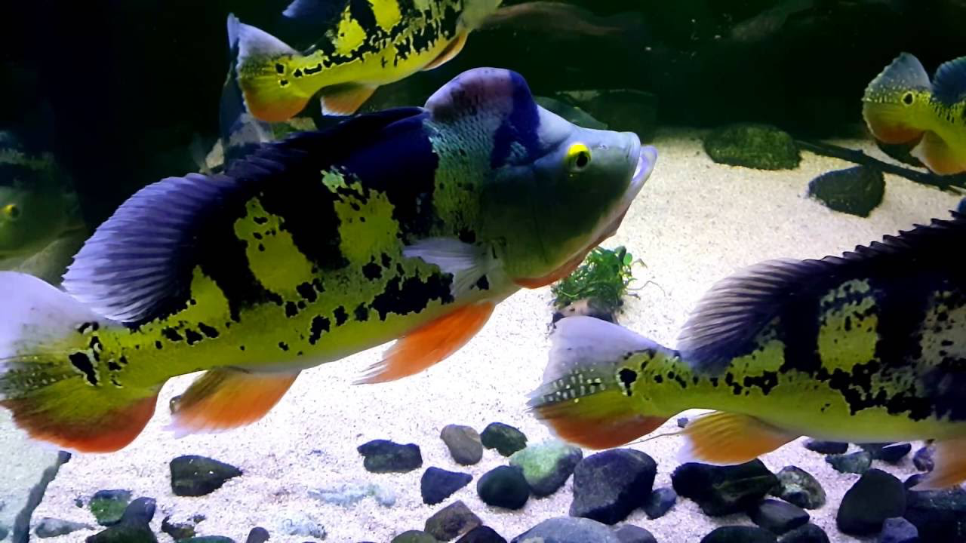
The visual system of an introduced cichlid in Lake Gatun: Cichla monoculus
Daniel Escobar-Camacho

Slide 3
Opsin Gene expression
Cichlids have 7 opsin genes but they typically express only 3 opsins

Slide 4
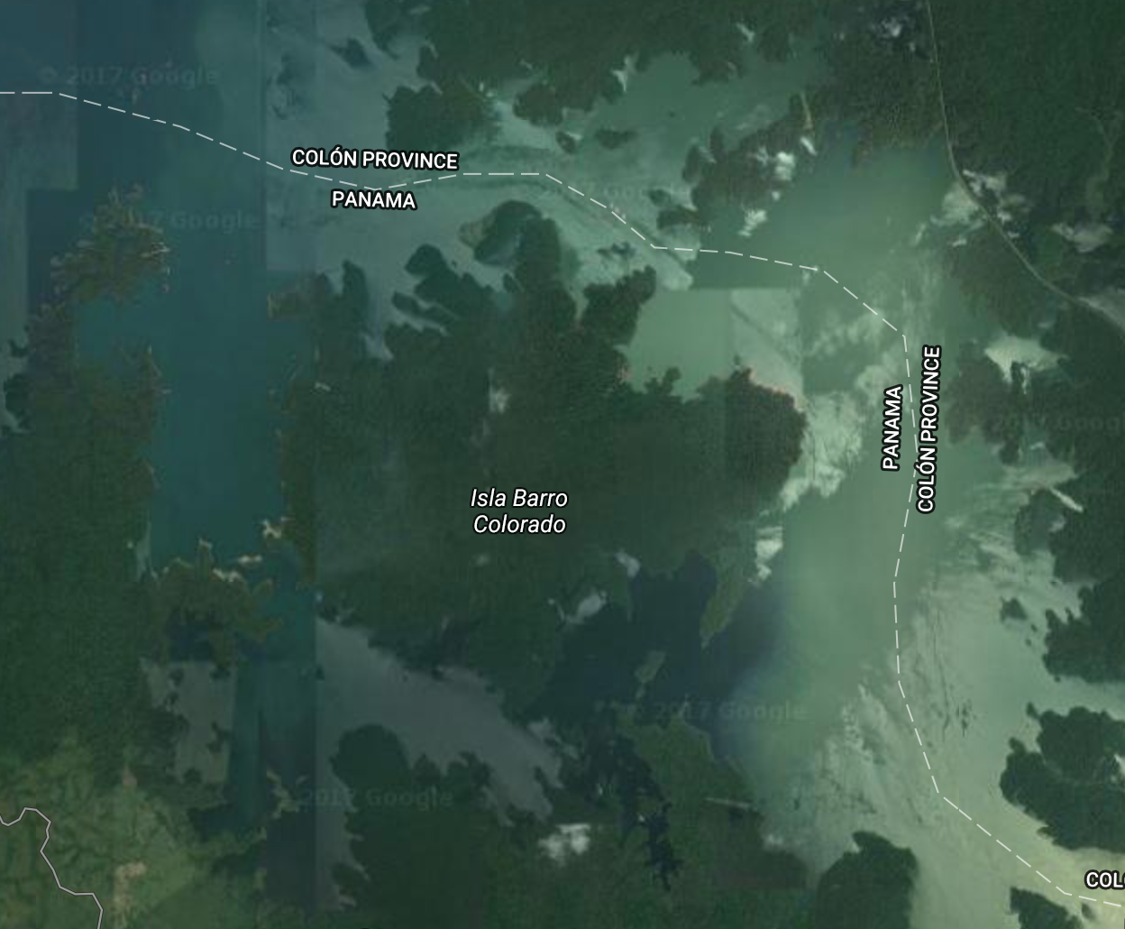
Barro Colorado Island (Panama)
Dock
Gigante

Slide 5
To do…
7 samples (3 murky & 4 clear water)
We want to know if there is differential gene expression between samples from different light environments.
We will put R to work and analyze this
What do we have to do this:
transcriptomes (Illumina reads)
Reference assembled genome of Tilapia

Slide 6
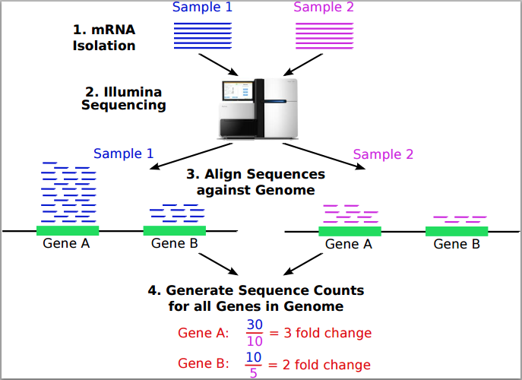
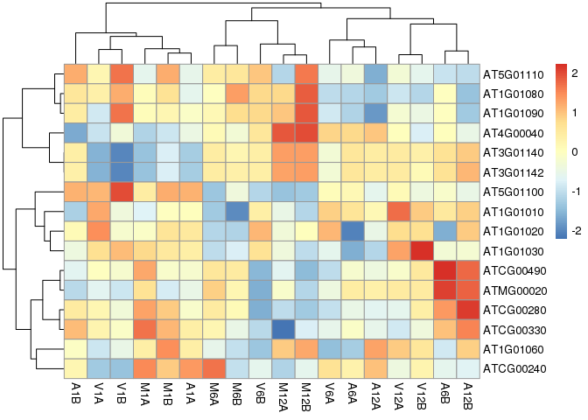
Workflow in bioconductor
FastQ Results
Alignment
Maps RNA-Seq reads. Align RNA-Seq reads to Tilapia genome. For this you need a genome and and an index of the reference genome
Read counting
Simple RPKM normalization (reads per kilobase of exon model per million mapped read). Abundance of transcripts in the form of counts.
Analysis of differentially expressed genes
Identify differentially expressed genes

Slide 7
FastQ Results
seeFastq and seeFastqPlot
Alignment
TopHat2
Read counting
TranscriptDb
Analysis of differentially expressed genes
run_edgeR and edgeR

